Slide 1
Objectives:
To determine the death rates of Veterans Hospitals in the States of Georgia and Virginia and compare the highest and lowest rates between facilities and states
To determine the average readmission rates of Veterans Hospitals in the States of Georgia and Virginia and compare the highest and lowest rates between facilities and states.

Slide 2
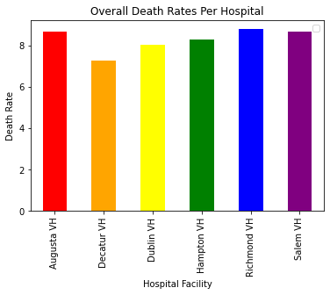

Slide 3
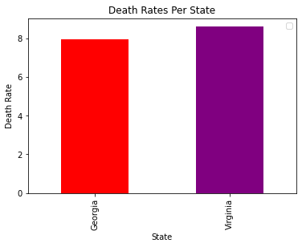

Slide 4
DEATH RATE OBSERVATIONS
The Facility with the lowest death rate is the Decatur(Atlanta) VA Medical Center
The Facility with the highest death rate is the Richmond VA Medical Center
On average, Veteran hospitals in the state of GA have the lowest death rates

Slide 5
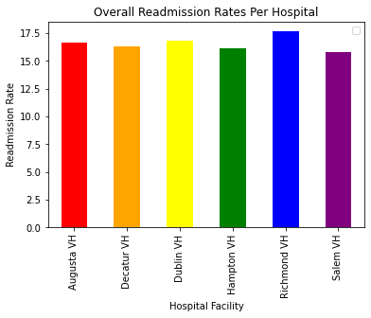

Slide 6
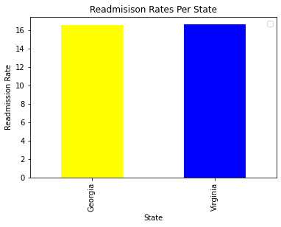

Slide 7
Readmission Rate Observations
The Facility with the lowest readmission rate is the Salem VA Medical Center
The Facility with the highest readmission rate is the Richmond VA Medical Center
On Average, Veteran hospitals in the state of Georgia have a lower readmission rates than the state of Virginia, although the rate difference is minimal

